Slide 1
Classes and Objects

Slide 2
Classes and Objects
A class is a logical representation of real time entity.
An object is a physical representation of real time entity.
A class can be used as blueprint of a object.
Object is an instance of a class.

Slide 3
Class is a means of defining new data types.
The data represented in the class are variables & methods.
These variables are called as instance variables because every object of that class contains a copy of those variables.

Slide 4
Object Properties
State: It is represented by attributes of an object.
Behavior: It is represented by methods of an object.
Identity: It gives a unique name to an object

Slide 5
class syntax:
class “class-name”
{
Datatype variables;
Methods;
}

Slide 6
Constructors
Constructor is a method which has a same name as class name & it is invoked automatically when object of particular class is created.
Constructors does not contain return types.
Constructor is used to initialize the object.
If there is no constructor in a class, compiler automatically creates a default constructor.
There are two types of Constructors
1) Default Constructor
2) Parameterized Constructor

Slide 7
1) Default Constructor:
Default Constructor is also called as Empty Constructor which has no arguments.
Example:

Slide 8
2) Parameterized Constructor:
Constructors with parameters is known as Parameterized Constructor.
Example:

Slide 9
  Constructor overloading :
  Using more than one constructor in a class is called as constructor overloading .
  Example :

Slide 10
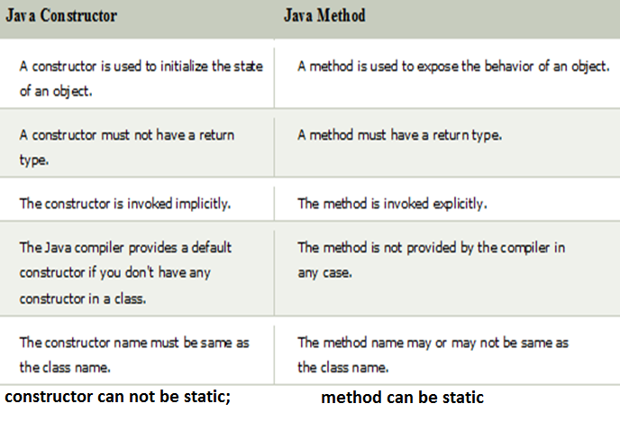
Differences between constructor and method

Slide 11
IMP points on constructor
A Java constructor cannot be abstract, static, final, and synchronized
We can use access modifiers while declaring a constructor. It controls the object creation. In other words, we can have private, protected, public or default constructor in Java.
If we declare constructor as private we can not create the object of that class at outside of a class

Slide 12
Q) Does constructor return any value?
Yes, it is the current class instance (You cannot use return type yet it returns a value).
Q) Can constructor perform other tasks instead of initialization?
Yes, like object creation, starting a thread, calling a method, etc. You can perform any operation in the constructor as you perform in the method.

Slide 13
Q) Is there Constructor class in Java?
Yes.
Q) What is the purpose of Constructor class?
Java provides a Constructor class which can be used to get the internal information of a constructor in the class. It is found in the java.lang.reflect package.

Slide 14
Q) Can constructors inherited?
No, constructors cannot be inherited in Java.
In inheritance sub class inherits the members of a super class except constructors.
Constructors are special and have same name as class name. So if constructors were inherited in child class then child class would contain a parent class constructor which is against the constraint that constructor should have same name as class name.
Q) Can we override constructors?
NO

Slide 15
For outer classes we can apply default or public access modifiers, then the access modifier of constructor (generated by java compiler) will be same as class.

